Slide 1
Assignment for AD programing
Name Rohullah
ID 19RX-200-243
Time morning
Teacher Roheed
Titall (Radio button and Dynamic polymorphism concept)

Slide 2
What is radio button
Radio Button is a class in C# that is found under System. Windows. Forms namespace. When you select any radio button in a set of radio buttons, you can display text, pictures, or both.
Why we used radio button
A radio button or option button enables the user to select a single option from a group of choices when paired with other Radio Button controls
Practical

Slide 3
Dynamic polymorphism
Dynamic polymorphism is a process or mechanism in which a call to an overridden method is to resolve at runtime rather than compile-time.
It is also known as runtime polymorphism or dynamic method dispatch. We can achieve dynamic polymorphism by using the method overriding.

Slide 4
Properties of Dynamic Polymorphism
It decides which method is to execute at runtime.
It can be achieved through dynamic binding.
It happens between different classes.
It is required where a subclass object is assigned to a super-class object for dynamic polymorphism.
Inheritance involved in dynamic polymorphism

Slide 5
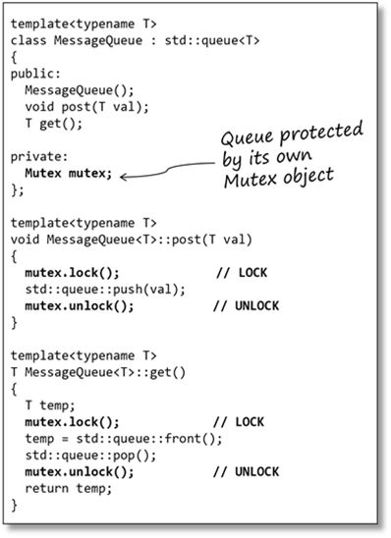
Example for dynamic polymorphism

